Slide 1
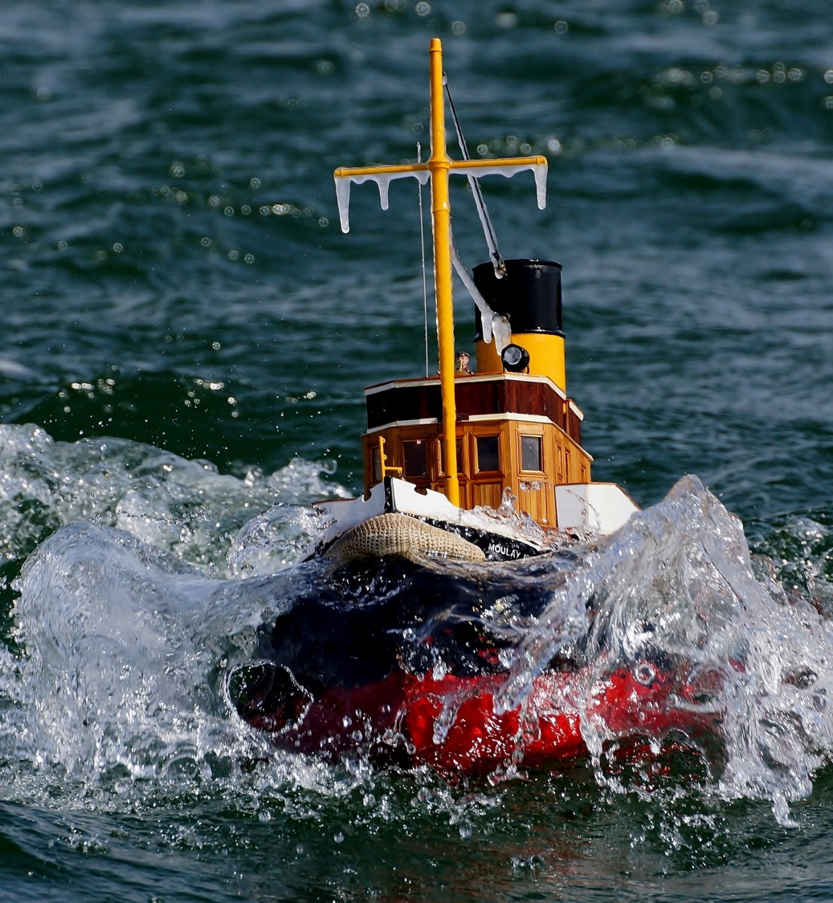
Managing a Response
Notes:
Welcome participants to Module 3: Managing a Response. Introduce the session's focus on how a spill response is organised and managed, building on the fate and effects concepts covered in Module 2.

Slide 2
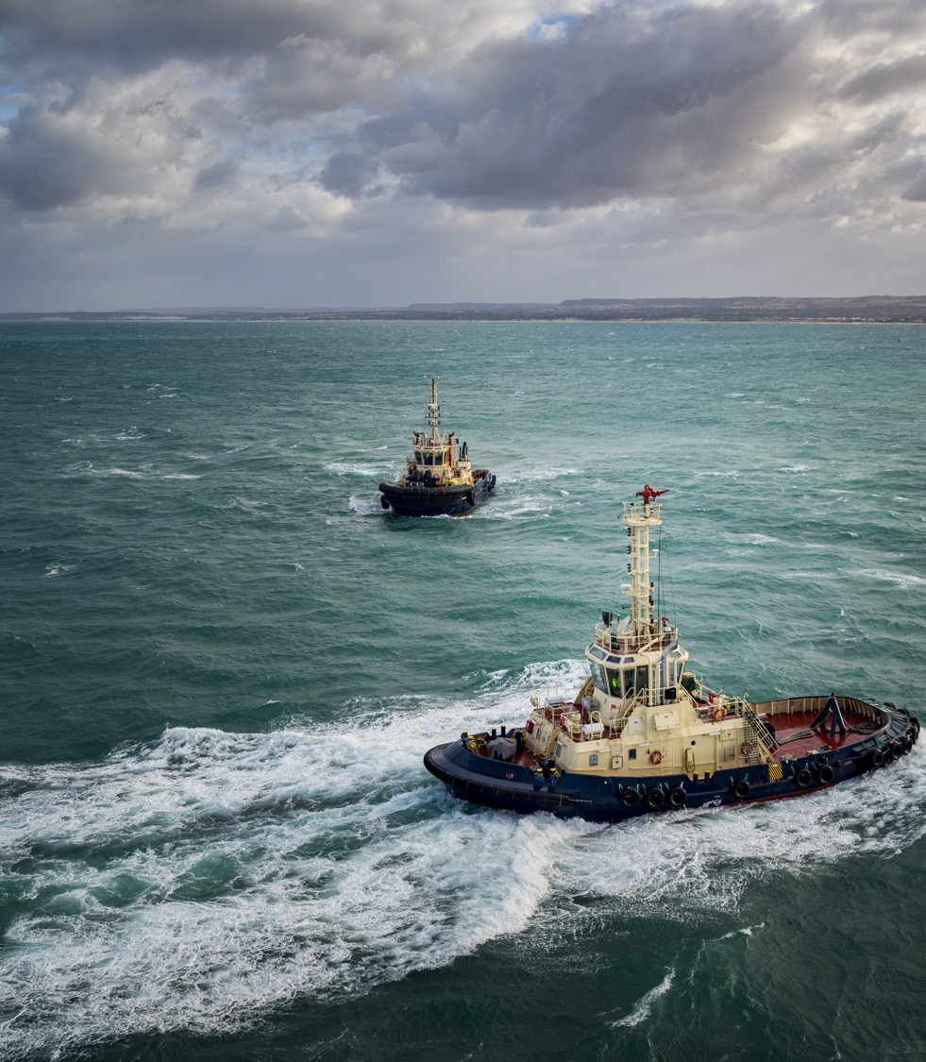

Managing a Response
Objectives
1
Understand the incident management system structure within your country at Tier 2 and Tier 3 levels
2
List the challenges of a multi country response
3
Highlight differences between Reactive vs Proactive spill management
Notes:
Walk through the three learning objectives for this session: (1) understand the incident management system structure within participants' own country at Tier 2 and Tier 3 levels, (2) list the challenges of a multi-country response, and (3) highlight the differences between reactive and proactive spill management.

Slide 3
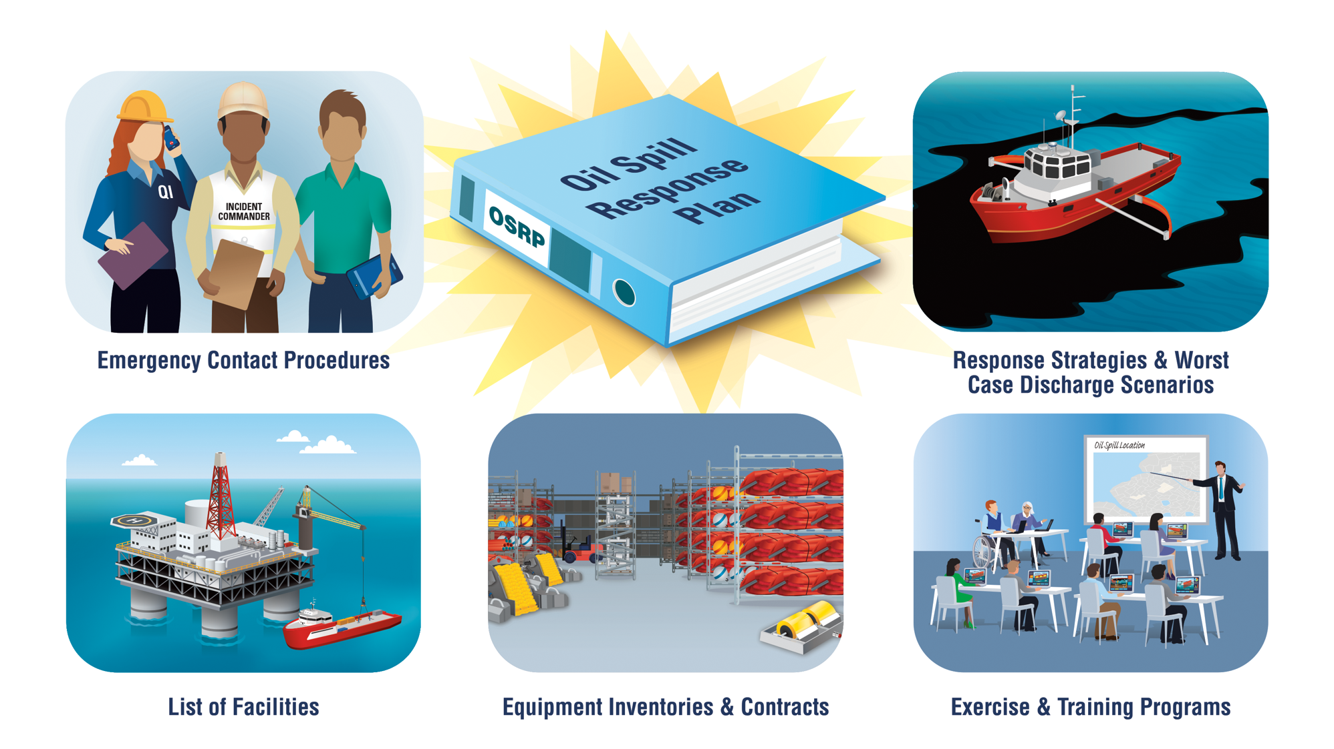
Notes:
Use this image to introduce the concept of an oil spill response plan — the documented structure that defines how a response is organised, resourced, and escalated.

Slide 4
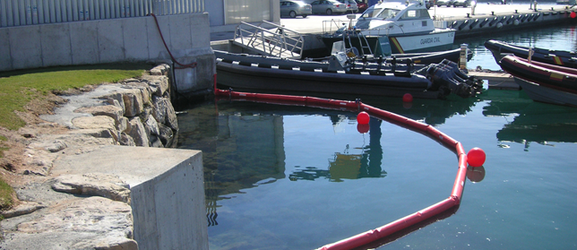
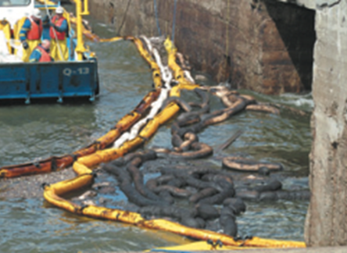
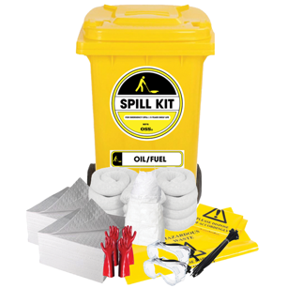
Tiered Response Capability – Tier 1
Local Resources: Utilizes resources held and managed locally by the operator to address spills.
Operational Nature: Focuses on spills that occur on or near the operator's facility.
Initial Response: Acts as the first line of defense against spills, addressing immediate impacts.
Escalation Preparedness: Provides foundational actions and resources that can handle incidents potentially escalating beyond initial capabilities.
Notes:
Introduce Tier 1 response capability: resources held and managed locally by the operator, focused on spills on or near the facility. Emphasise that Tier 1 acts as the first line of defense and provides the foundation that later tiers build on if an incident escalates.

Slide 5
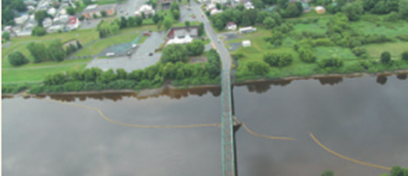
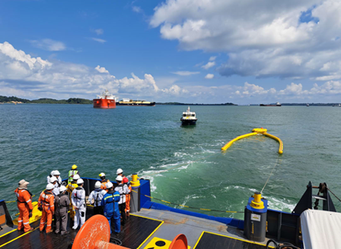
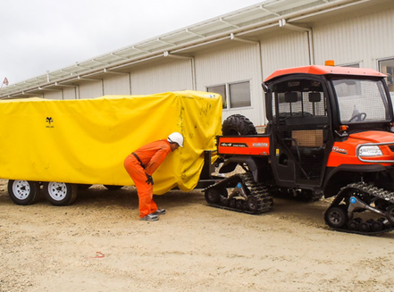
Tiered Response Capability – Tier 2
Supplementary Resources: Includes additional resources that supplement the Tier 1 response.
Shared Resources: Often involves resources that are shared at a national or regional level.
Escalating Response Support: Designed to support responses that escalate beyond the initial Tier 1 capabilities.
Broad Equipment and Expertise: Features a wider selection of specialized equipment and expertise.
Strategic Response Options: Suited for a variety of strategic responses to manage larger or more complex incidents.
Notes:
Introduce Tier 2 response capability: supplementary resources, often shared at a national or regional level, that support a response escalating beyond Tier 1. Highlight the broader range of specialised equipment, expertise, and strategic response options available at this tier.

Slide 6
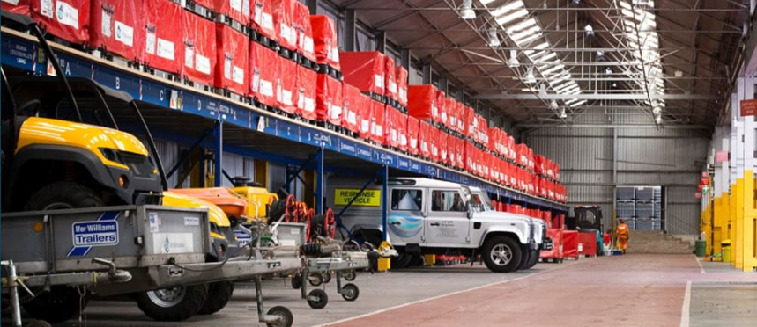
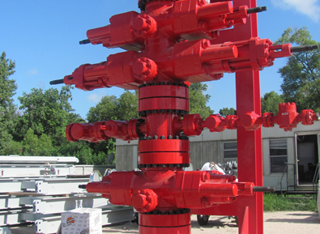
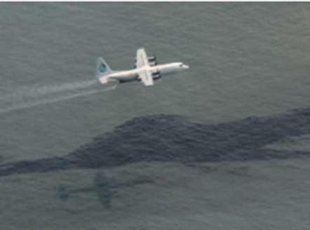
Tiered Response Capability – Tier 3
Global Resources: Comprise globally available resources.
Supplements Tiers 1 and 2: Further supports and enhances the lower-tier responses.
International Resources: Utilizes international resources for large-scale incidents.
Addressing Major Incidents: Necessary for handling spills with significant scale, complexity, or potential impact.
Notes:
Introduce Tier 3 response capability: globally available resources that supplement Tiers 1 and 2. Emphasise that Tier 3 draws on international resources and is necessary for major incidents of significant scale, complexity, or potential impact.

Slide 7

What are the principles of ICS/IMS?
Can you list as many terms and phrases as possible
Notes:
Establish & Maintain Command
Common and Consistent Terminology
Organisation by Function
Span of Control
Coordination and Management of Resources
Integrated Communications
Objectives-driven Response
Accountability
Information and Intelligence Management
Safety
Chain of Command and Unity of Command
Modular Organisation
Incident Action Planning
Team work

Slide 8
Tier 2 and 3 Response
INSERT client’s tier 2 and 3 response here as per their contingency plan
Find out (add more as required):
What is the tier 2 response structure?
Who is your Tier 2 agency?
What is the tier 2 response structure?
What are Tier 3 resources?
Notes:
Facilitation slide — insert the client's own Tier 2 and Tier 3 response structure here, as documented in their contingency plan. Use the prompts to guide discussion: What is the Tier 2 response structure? Who is the Tier 2 agency? What Tier 3 resources are available?

Slide 9
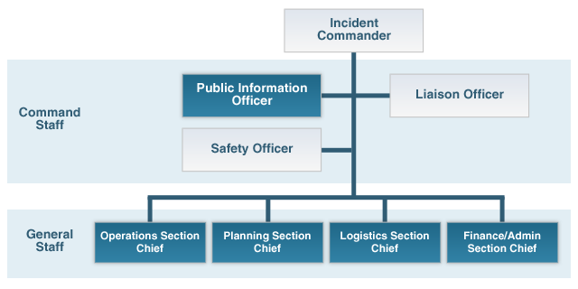
Organisation by Function
Notes:
ICS requires that one or more individuals maintain authority over all incident activities. This position is known as the Command function. For small incidents a single person, called the Incident Commander (IC), can typically perform the Command function. For large incidents, the positions of Deputy Incident Commander and Command Staff Officers may be assigned to support the Incident Commander.
Organisational elements (Sections) are added to the ICS structure as additional personnel (General Staff) and new functions and capabilities are brought into the incident response and assigned to the various organisational elements.

Slide 10
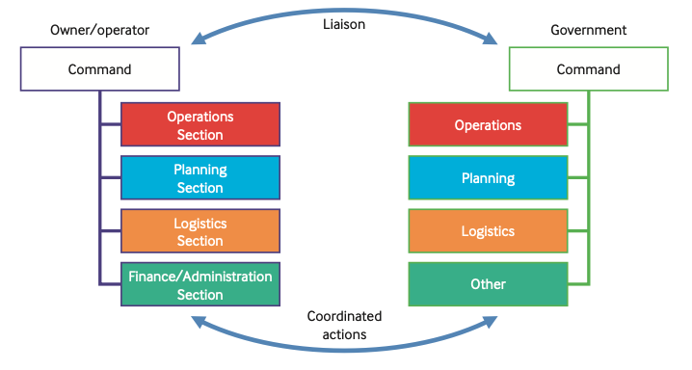
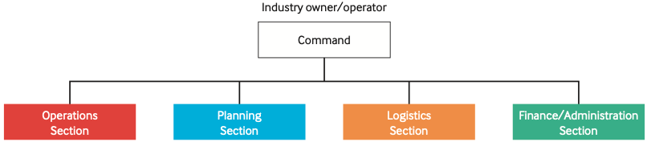
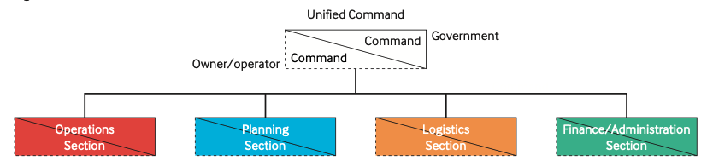
Types of Command
Unified Command
Company and Government respond jointly
Actions and Information are integrated
Single Command
Coordinated Command
Managed directly by Company or Government
Actions and Information are provided
Company and Government respond in paralle
Actions and Information are coordinated
Notes:
Explain the three types of command structure shown: Single Command (managed directly by the company or government, with actions and information provided one-directionally), Coordinated Command (company and government respond in parallel, with actions and information coordinated between them), and Unified Command (company and government respond jointly, with actions and information fully integrated).

Slide 11

IPIECA Guide - IMS
What are the following responsibilities? Pg.11
Finance
Logistics
Operations
Planning
Command
Where would you sit?
Notes:
ICS requires that one or more individuals maintain authority over all incident activities. This position is known as the Command function. For small incidents a single person, called the Incident Commander (IC), can typically perform the Command function. For large incidents, the positions of Deputy Incident Commander and Command Staff Officers may be assigned to support the Incident Commander.
Organisational elements (Sections) are added to the ICS structure as additional personnel (General Staff) and new functions and capabilities are brought into the incident response and assigned to the various organisational elements.

Slide 12
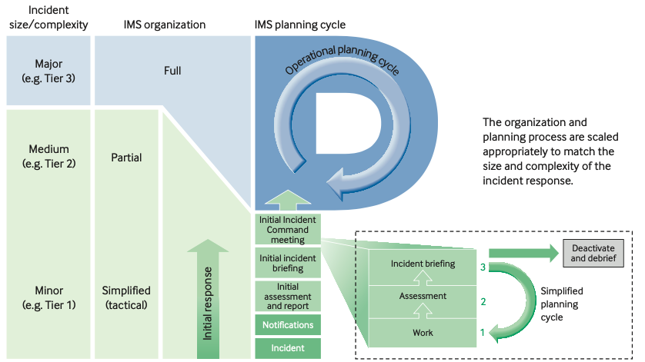
Tiered Response
Notes:
Show the full tiered response diagram, tying together Tier 1, Tier 2, and Tier 3 capabilities and how a response escalates across tiers as an incident grows in scale.

Slide 13
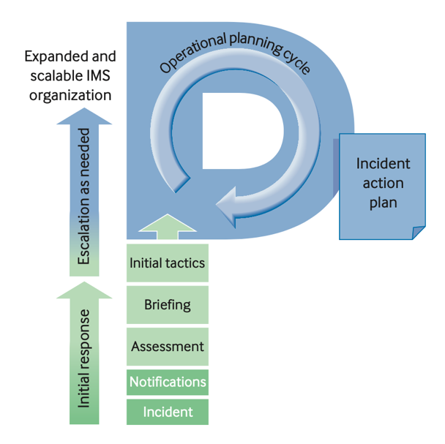
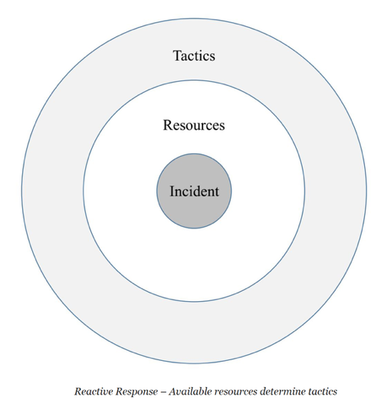
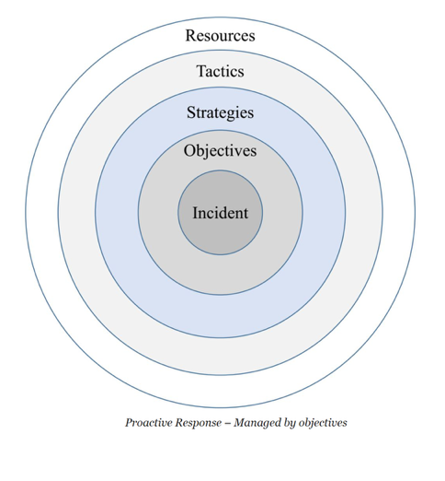
Reactive Vs. Proactive Response
Reactive
Proactive
Notes:
Compare reactive versus proactive response approaches. Reactive response addresses events as they unfold; proactive response anticipates needs and plans ahead of how the incident will develop. Discuss the advantages of shifting toward a more proactive posture during a response.

Slide 14
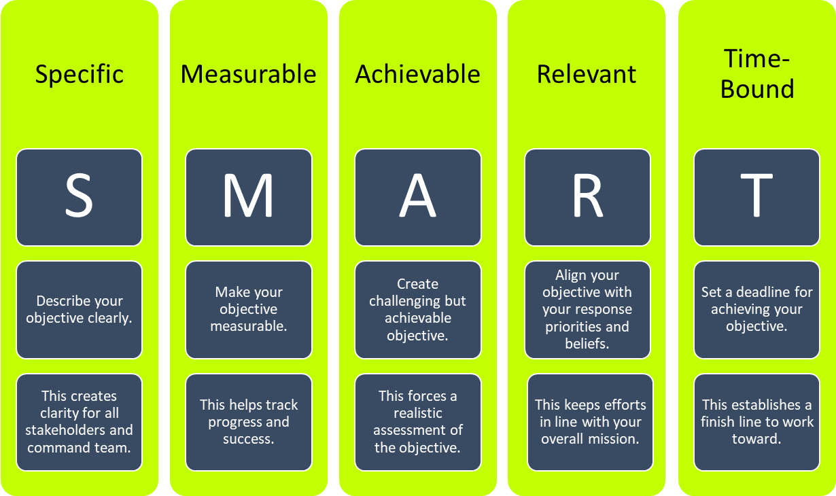
SMART Objective Driven Response
Notes:
Introduce SMART objective-driven response: objectives set for each operational period should be Specific, Measurable, Achievable, Relevant, and Time-bound, so that response actions stay focused and progress can be clearly assessed and reported.

Slide 15

Response Principles
People
Environment
Assets
Reputation
Notes:
Introduce the four response priorities represented here: People, Environment, Assets, and Reputation (PEAR). Explain that these four priorities frame all objective-setting and decision-making throughout a response.

Slide 16
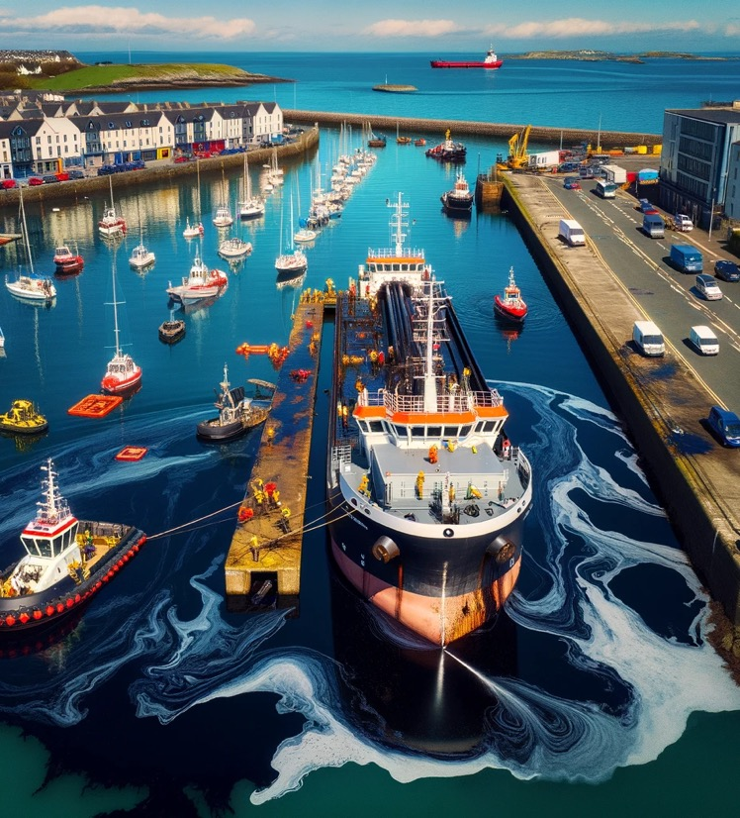
Objectives - PEAR
Scenario: Fuel oil spilt in harbour during bunkering options
Objective
Objectives are the overarching goals that define what the response aims to achieve, focusing on broad outcomes like minimizing environmental impact or protecting sensitive habitats.
Objectives
People
Environment
Assets
Reputation
Notes:
Using the harbour bunkering scenario, work through setting response objectives across the four PEAR categories (People, Environment, Assets, Reputation). Explain that objectives are the overarching goals defining what the response aims to achieve — e.g. minimising environmental impact or protecting sensitive habitats — and have participants complete the table for the scenario.

Slide 17

Strategies + Tactics
Scenario: Fuel oil spilt in harbour during bunkering options
Strategy
Strategies outline the approaches to achieve the objectives, guiding the overall plan of action, such as deploying containment booms or using dispersants.
Tactic
Strategies and Tactics
Strategy | Tactic
Tactics are the specific, detailed actions taken to implement strategies, like the precise deployment of skimmers or manual oil removal from beaches.
Notes:
Continuing the harbour bunkering scenario, distinguish strategies from tactics. Strategies are the overall approaches used to achieve the objectives (e.g. deploying containment booms or using dispersants); tactics are the specific actions taken to implement a strategy (e.g. precise skimmer deployment or manual beach clean-up). Have participants complete the strategy/tactic table for the scenario.

Slide 18
Incident Action Plans
Responsibility
Responsibility
Planning Section
Objectives and priorities for next operational period
Field Assignments for next operational period
Primary Contents
Process
Achieve a proactive response by providing guidance to tactical responders on the objectives and priorities for the next operational period (NOP)
Define Tactical Objectives and priorities
Prepare field assignments
Prepare support documents
Finalise, approve, and implement plan
Notes:
Explain the Incident Action Plan (IAP) process: the Planning Section defines tactical objectives and priorities, prepares field assignments and support documents, and finalises, approves, and implements the plan for the next operational period. Emphasise that a strong IAP is what enables a proactive, rather than reactive, response.

Slide 19

What does a successful response look like?
List bullet points
Notes:
Determining the success of an oil spill response involves evaluating several key performance indicators. Here are concise bullet points to guide such an assessment:
- Environmental Recovery: Extent of environmental restoration to pre-spill conditions.
- Wildlife Rehabilitation: Number and health of wildlife rehabilitated and released.
- Containment Efficiency: Percentage of oil effectively contained and recovered.
- Response Time: Speed of initial response and mobilization of resources.
- Stakeholder Satisfaction: Feedback from affected communities, local governments, and environmental groups.
- Adherence to Regulations: Compliance with environmental laws and guidelines during the response.
- Cost Efficiency: Total costs compared to budget, including cleanup and damage mitigation.
- Incident Analysis: Thorough review of response actions, highlighting successes and areas for improvement.
- Media and Public Relations: Positive or neutral media coverage and public perception of the response efforts.
By measuring these aspects, organizations can gauge the effectiveness of their response and identify areas for improvement in future incidents.

